Slide 1
SP3D Structure Reference Data

Slide 2
Outline
  SP3D Databases Overview
  Delivered Catalog Database
  Catalog Creation
  Bulkload Utility
  Code List
  Cross Sections
  Part Class
  Parts
  Custom interface
  2D Symbol Utility
  Openings
  2D Symbol Utility
  Slab Reference Data
© 2009. Intergraph Corporation. All Rights Reserved.

Slide 3
Using Excel Workbooks to Configure Structure Reference Data
  All non-graphical SmartPlant 3D reference data is stored in Microsoft Excel
  Workbooks. The default location for structure reference data workbooks is [ProductDirectory]\Catalog Data\BulkLoad\DataFiles.
StructCrossSections-AISC-LRFD-3.0.xls
StructCrossSections-AISC-LRFD-3.1.xls
StructCrossSections-MISCSHAPES-1.0.xls
StructSplitConnections.xls
StructFrameConnections.xls
StructAssemblyConnections.xls
StructPlateDimensions.xls
StructEquipFoundations.xls
StructStairs.xls
StructLadders.xls
StructHandrails.xls
StructFootings.xls
StructOpeningsMetric.xls
StructSlabGeneral.xls
StructSlabLayer.xls
StructSlabAssemblyConnections.xls
© 2009. Intergraph Corporation. All Rights Reserved.

Slide 4
Using Excel Workbooks to Configure Structure Reference Data
  Additional Reference Data is located in [Product Directory] \CatalogData\BulkLoad\AdditionalDataFiles
StructCrossSections-Euro.xls
StructCrossSections-Japan.xls
StructCrossSections-CISC_7.2.xls
StructCrossSections-AUST-05.xls
StructCrossSections-EURO-OTUA-2002.xls
© 2009. Intergraph Corporation. All Rights Reserved.

Slide 5
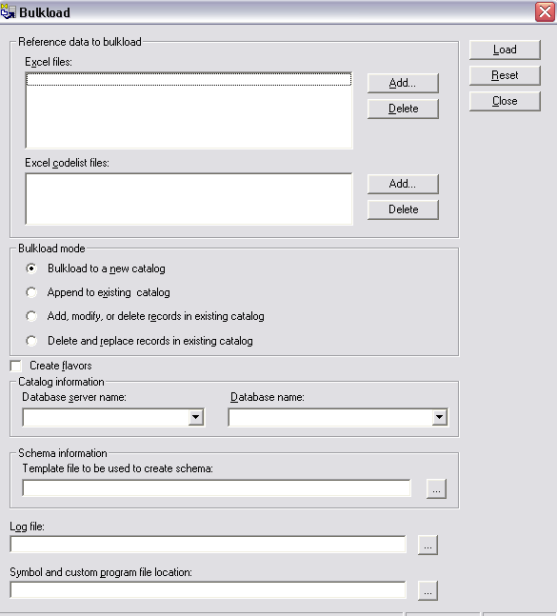
Bulkload Utility
The Bulkload Utility provides the primary mechanism to create/add/modify the catalog database. The data for creating the database is defined using Excel workbooks.
Bulkload Mode:
  Bulkload to a new catalog: is used for creating new catalog database
  Append: is used for creating new Classes
  Add/Modify/Delete: is used for updating part data
  Delete & Replace: is used to replace data in the database with the data currently in the workbooks
© 2009. Intergraph Corporation. All Rights Reserved.

Slide 6
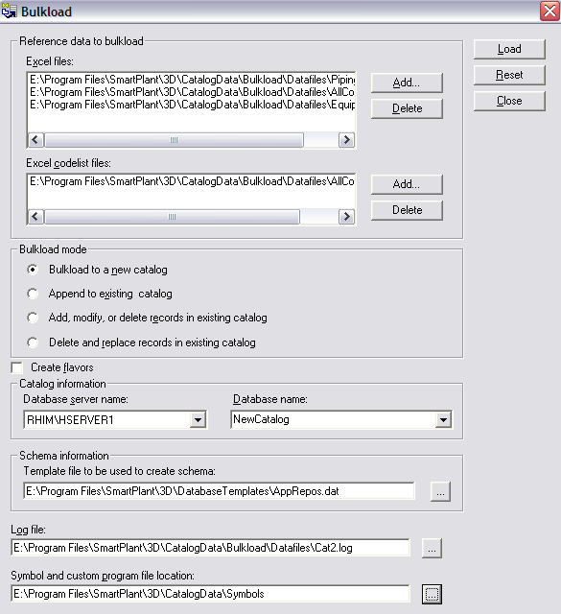
Bulkload Utility
Create New Catalog
- Bulkload to a new catalog
© 2009. Intergraph Corporation. All Rights Reserved.

Slide 7
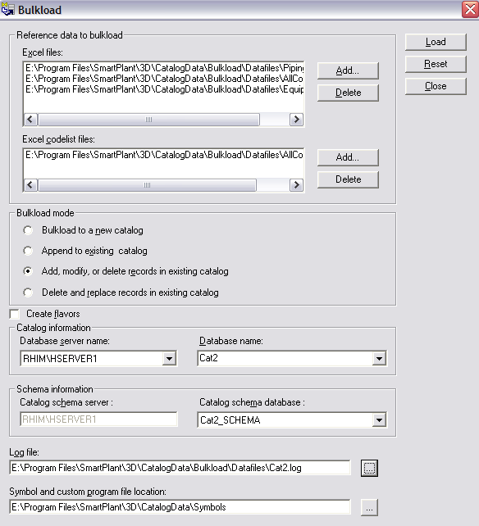
Bulkload Utility
Mode:
Append
Add/Modify/Delete
Create Flavors
Flavors apply to
Solid Edge parts only.
You should close all Excel workbooks
before starting the bulkload. Do not
open Excel during the bulkload.
© 2009. Intergraph Corporation. All Rights Reserved.

Slide 8
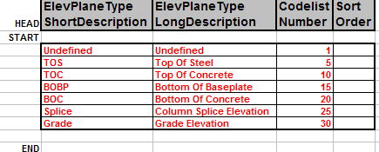
Code List
Codelists – Key or common terms that have been grouped and enumerated.
Key Columns:
  Short/Long Description
  Codelist Number
  Sort Order (Not used in 6.0)
© 2009. Intergraph Corporation. All Rights Reserved.

Slide 9
Reference Data Management
Step 1
Bulk Load Utility
Step 2
View Generator Utility or Synchronize Model with Catalog Command
Step 3
Re-generate the reports database command
Catalog &
Catalog Schema
Model
Report &
Report Schema
Bulk load utility will update the views in the catalog database
View Generator Utility will update the views in the model database
Synchronize model with catalog command will update the views and re-compute all the part occurrences in the model
Re-generate the report database command will re-generate the views in the model.
© 2009. Intergraph Corporation. All Rights Reserved.
Notes:
10
6

Slide 10
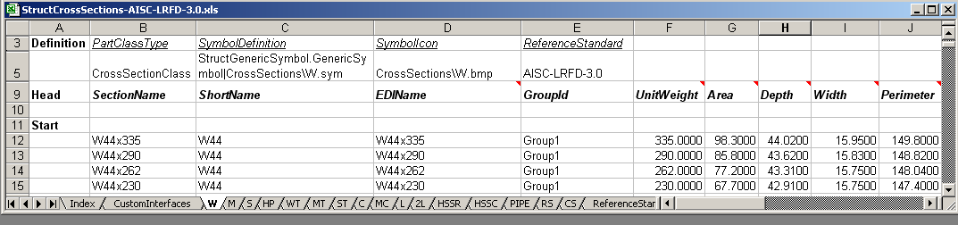
Part Classes
A Part Class is a grouping of parts that share similar characteristics
© 2009. Intergraph Corporation. All Rights Reserved.

Slide 11
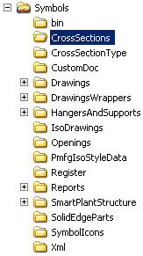
Part Class Definition
  Part Class Type: Type of Part Class.
  Symbol Definition: Default Geometric definition for all the parts under this class.
  SymbolIcon: Specifies a graphic file for the preview dialog of the part class.
  Reference Standard: Specifies the Reference standard that the part class belongs to.
© 2009. Intergraph Corporation. All Rights Reserved.

Slide 12
Parts
Part section consists of the following:
Common Properties
Custom Properties
© 2009. Intergraph Corporation. All Rights Reserved.

Slide 13





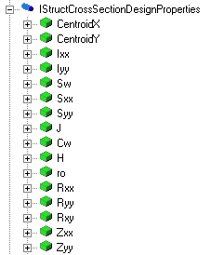
Cross Section Data Model
Common Properties
Custom Properties
The Custom Interfaces sheet defines user interfaces and attributes (properties) for the part classes.
© 2009. Intergraph Corporation. All Rights Reserved.
Notes:
10
6

Slide 14
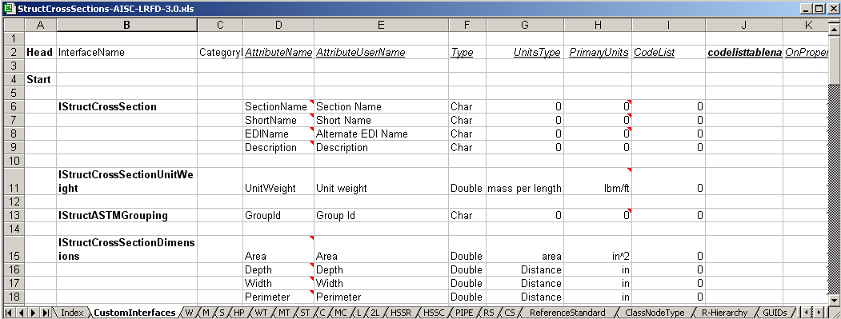
Custom Interfaces Sheet
  The Custom Interfaces sheet defines the user interfaces and attributes (properties) for the part classes in the workbook.
  An interface is a collection of attributes.
  Provides a mechanism to map the attributes of the part class to the symbol inputs.
© 2009. Intergraph Corporation. All Rights Reserved.

Slide 15
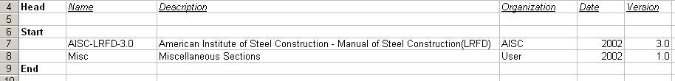
Reference Standard sheet
Reference Standards – Published document standards
  Name
  Description
  Organization
  Date
  Version
© 2009. Intergraph Corporation. All Rights Reserved.

Slide 16
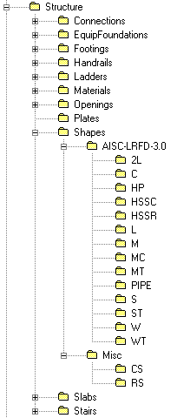
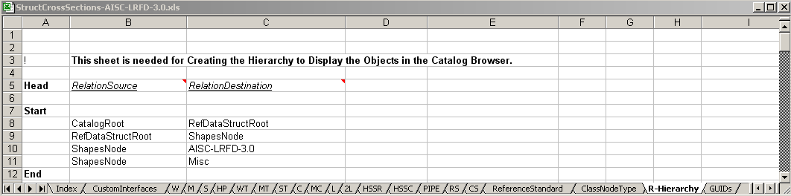
Organizational Hierarchy Sheets
© 2009. Intergraph Corporation. All Rights Reserved.

Slide 17
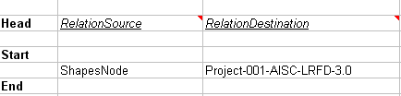
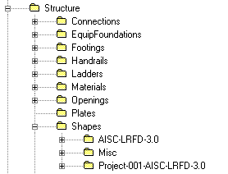
Using Excel Workbooks to Configure
Reference Data:
  R-Hierarchy: contains the parent-child relationships between folders in the Catalog Hierarchy.
RelationSource column: specifies the parent object names.
RelationDestination column: specifies the children object names.
© 2009. Intergraph Corporation. All Rights Reserved.

Slide 18

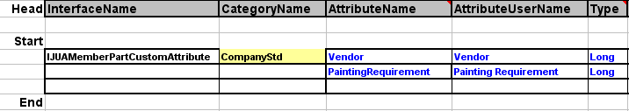
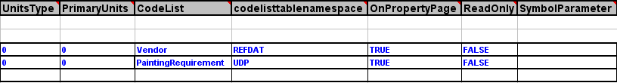
CustomClassInterfaceList sheet
Provides method for adding custom properties to Objects
Custom Interface sheet
© 2009. Intergraph Corporation. All Rights Reserved.

Slide 19

CustomClassInterfaceList sheet
Class Name:
CSPSMemberPartPrismatic
CSPSMemberSystemLinear
CSPSFrameConnection
CSPSFooting
CSPSEquipFoundation
CSPSHandrail
CSPSLadder
CSPSStair, etc…..
© 2009. Intergraph Corporation. All Rights Reserved.

Slide 20
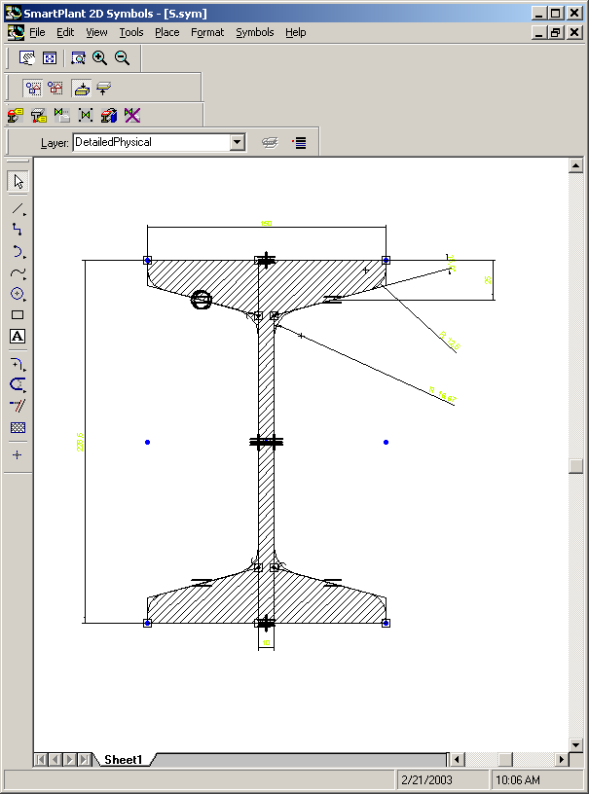
Symbol Definition – 2D Symbols
Symbols: What is it ?
Reusability of Graphical Entities
Probably the most used entity by SmartPlant 3D Applications.
Symbols can be created as:
Programmatical Constructions: A program (VB, C++, etc..)
Graphical Constructions (SolidEdge or Shape 2D):
  2D Symbols Cross-section file (.sym)
  Equipment symbols (. asm/par)
© 2009. Intergraph Corporation. All Rights Reserved.

Slide 21
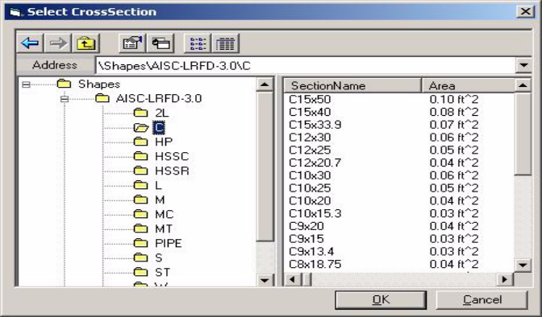
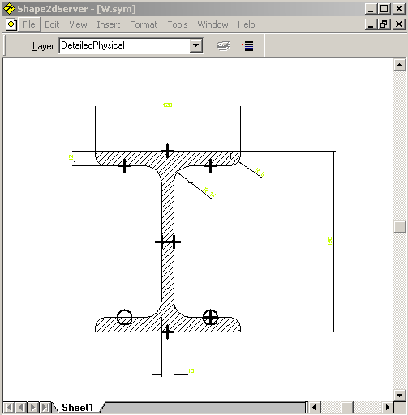
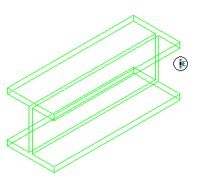
Prismatic Part
Single-solid entities geometrically described as a surface of projection. The axis of a member part is a portion of the system axis.
Prismatic Parts will be created by a projection of a cross section definition stored in a parametric symbol file.
System uses these symbol files to generate the member objects based on reference data stored in the catalog.
Catalog
Symbol 2D Utility
w.sym
© 2009. Intergraph Corporation. All Rights Reserved.

Slide 22
2D Symbol Utility
is a 2D Drafting Environment that allows users to create a symbol definition so that it can be placed in the model.
This utility provides the tools to:
  Draw the graphic representation of the symbol.
  Specify the parameters that will control the symbol geometry.
  Name the geometric elements (ex: arcs, lines).
  Add the symbol definition to the catalog spreadsheet that can later be bulk loaded into the catalog database.
© 2009. Intergraph Corporation. All Rights Reserved.

Slide 23
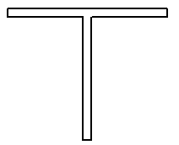
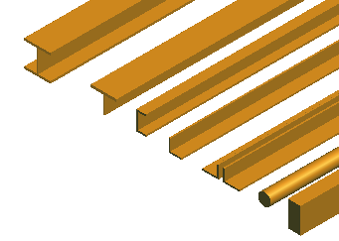
2D Symbol Utility
Profile Symbol representations
The “Simple Physical” aspect is used for persistent modeled geometry and display.
Simple
© 2009. Intergraph Corporation. All Rights Reserved.

Slide 24
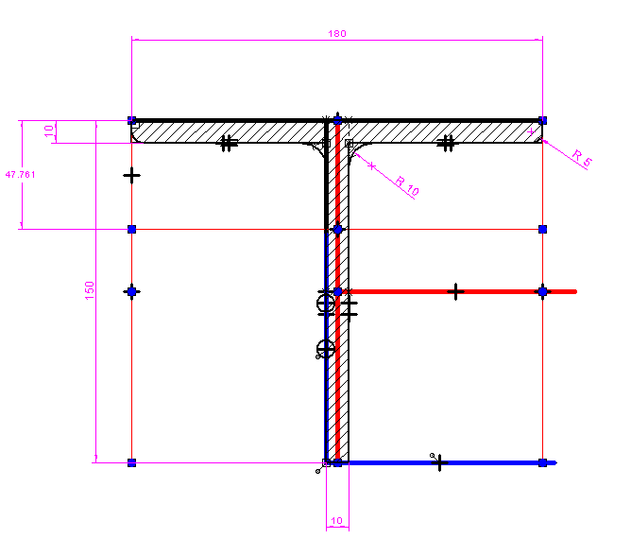
2D Symbol Utility
Layers
  Can help groups elements so they can manipulated more easily on the drawing sheet.
Symbol Organization
  Constructions
  Simple Physical
  Detailed Physical
  Dimensions
  Points
Hatch Layer
Construction Layer
Load Layer
Dimension Layer
Simple Physical Layer
Detailed Physical Layer
© 2009. Intergraph Corporation. All Rights Reserved.

Slide 25
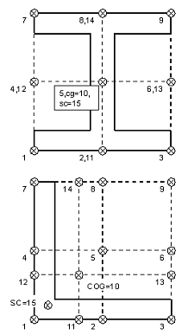
2D Symbol Utility
Load Points
A load point, commonly referred to as a cardinal point, defines the location where the software displays the profile cross-section on the member logical axis.
CP 8
CP 2
Member logical axis
© 2009. Intergraph Corporation. All Rights Reserved.

Slide 26
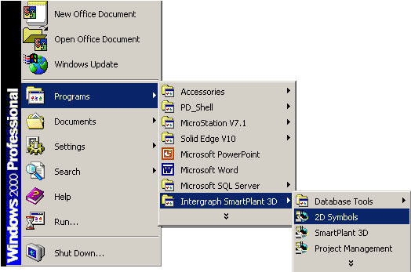
2D Symbol Utility
Run the utility:
The Symbol2D shortcut is located at \\SmartPlant\3D\Symbol2D\Environment\Bin
© 2009. Intergraph Corporation. All Rights Reserved.

Slide 27
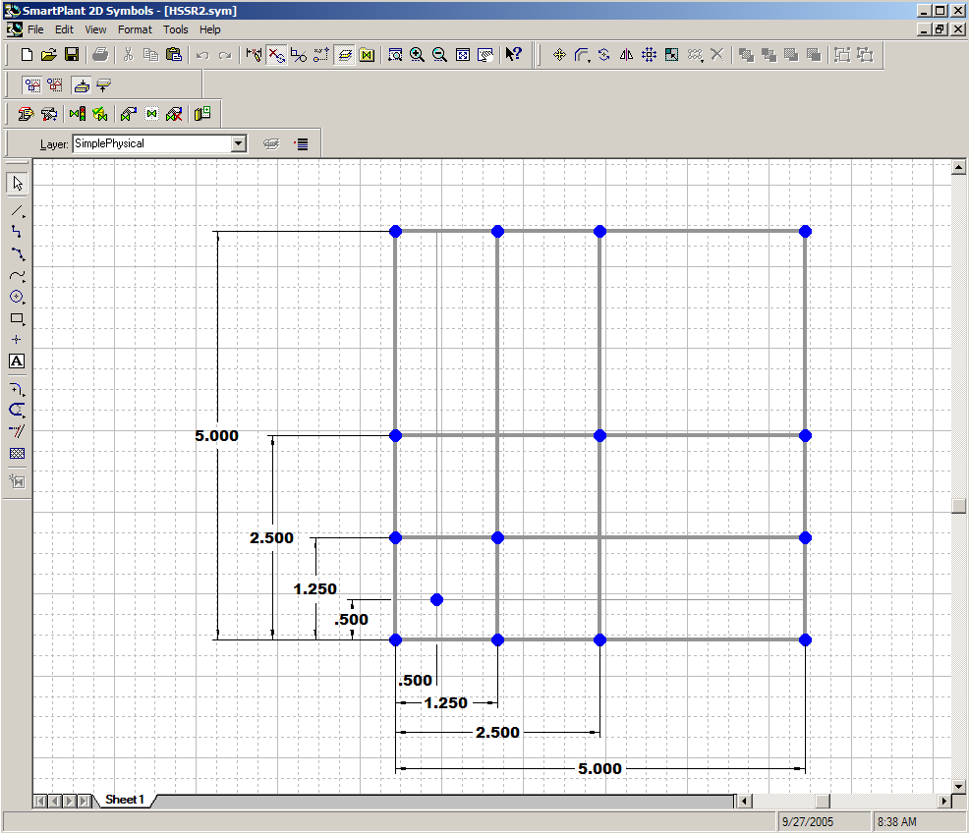
2D Symbol Utility
Main Menu
Ribbon bars
2D Drafting Environment
Common Windows Interface
  - Ribbon Bars
  - Graphic Views
Section dialog bar
Active View
Draw Toolbar
Status Bar
© 2009. Intergraph Corporation. All Rights Reserved.

Slide 28
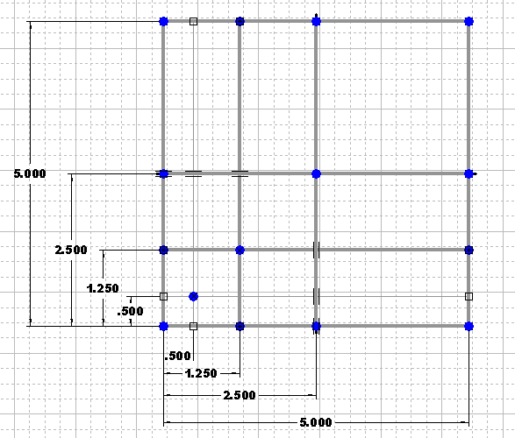
2D Symbol Utility
Delivered Template
[Install Directory]\Common2D\Symbol2D\Templates
CrossSectionTemplate.sym
- Layers
- Construction lines
- Load points
- Dimensions
© 2009. Intergraph Corporation. All Rights Reserved.

Slide 29
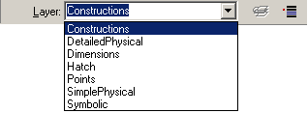
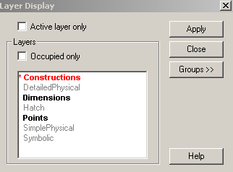
2D Symbol Utility
Manage layers
Click Tools -> Layers to display the layer toolbar.
© 2009. Intergraph Corporation. All Rights Reserved.

Slide 30

2D Symbol Utility
View Manipulation Tools
Pan
Fit
Window Area
Zoom in
Zoom out
Zoom out
Pan
Fit
Window Area
Zoom In
© 2009. Intergraph Corporation. All Rights Reserved.

Slide 31

2D Symbol Utility
Drawing Tools
- Select Command
- Place Line
- Place Fillet
- Place Point
Place Line
Place fillet
Place point
Select Command
© 2009. Intergraph Corporation. All Rights Reserved.

Slide 32

2D Symbol Utility
Relationship Tools
Perpendicular
Collinear
Equal
Connect
Horizontal/Vertical
Parallel
Symmetric
Turn on/off Relationships/Indicators
© 2009. Intergraph Corporation. All Rights Reserved.

Slide 33

2D Symbol Utility
Change Tools
Offset
Delete
Mirror
Group
Ungroup
Move/
Copy
Rotate
© 2009. Intergraph Corporation. All Rights Reserved.

Slide 34
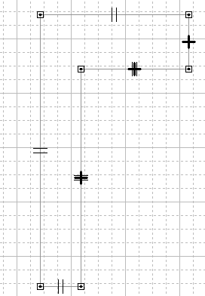
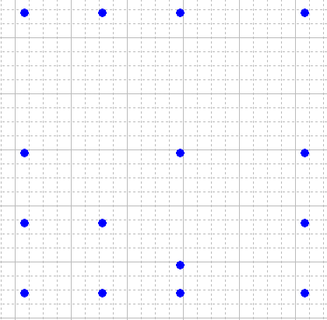
2D Symbol Utility
Creating Profile Geometry Groups
Select the lines and arcs that define the
contour of the profile.
Group
Ungroup
Simple
Load Points
© 2009. Intergraph Corporation. All Rights Reserved.

Slide 35
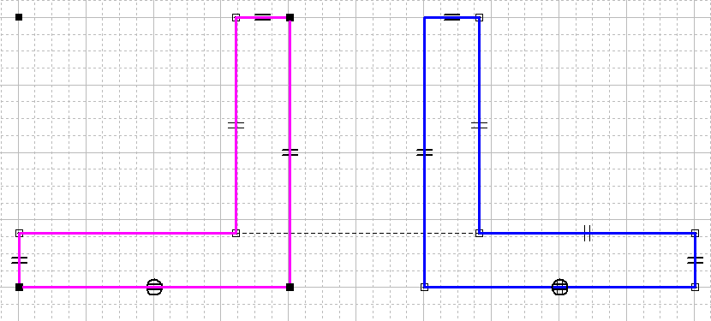
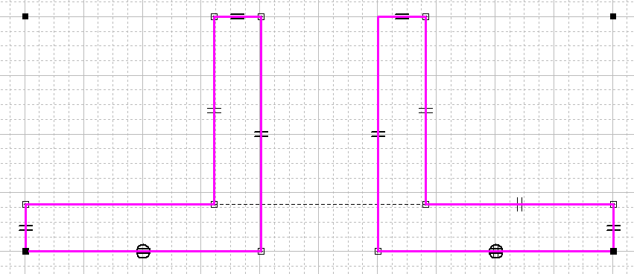
2D Symbol Utility
Creating Profile Geometry Groups
Select the lines and arcs that define the contour of the profile.
Group
Ungroup
First shape
Second shape
Nested grouped
© 2009. Intergraph Corporation. All Rights Reserved.

Slide 36
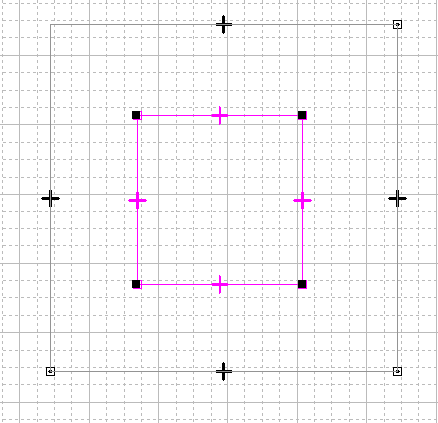
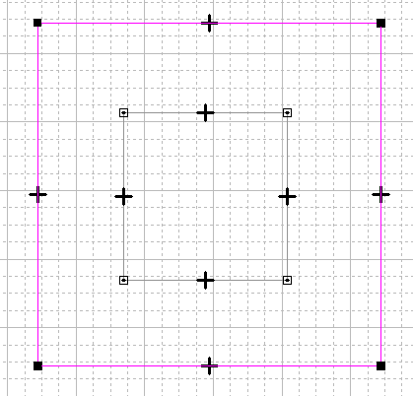
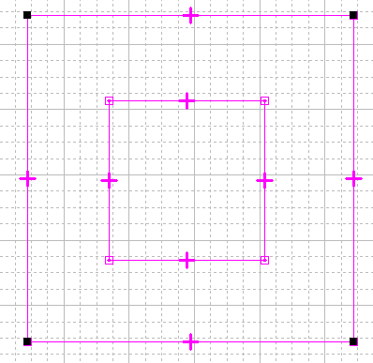
2D Symbol Utility
Creating Profile Geometry Groups
Select the lines and arcs that define the contour of the profile.
Ungroup
Group
First shape
Second shape
Nested grouped
© 2009. Intergraph Corporation. All Rights Reserved.

Slide 37
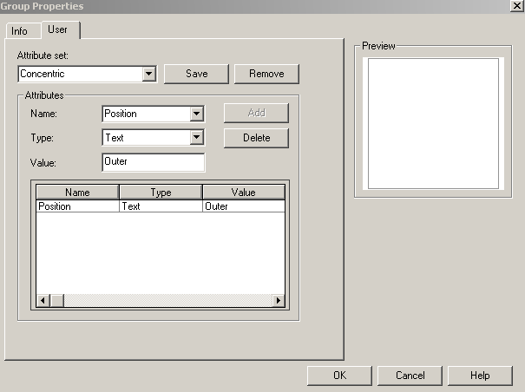
2D Symbol Utility
Creating Profile with Holes
Select the group that define the outer contour of the profile.
© 2009. Intergraph Corporation. All Rights Reserved.

Slide 38

2D Symbol Utility
Dimension Tools
Smart Dimension Command
Distance Between Command
Smart Dimension
Distance Between
  Dimension Variables are created for each dimensions.
© 2009. Intergraph Corporation. All Rights Reserved.

Slide 39
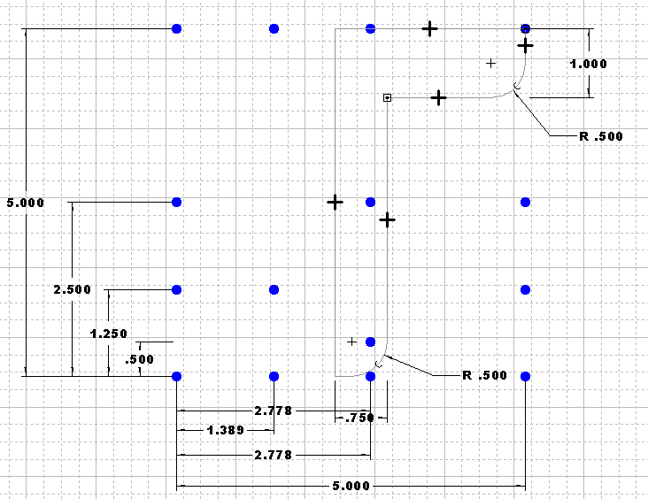
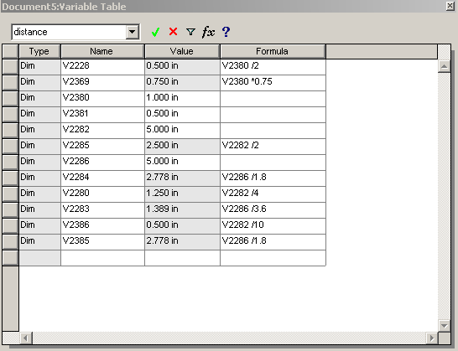
2D Symbol Utility
Variable Table allows you to define and manipulate dimension variables and their values, as well as establish functional relationships (formulas) between the variables.
© 2009. Intergraph Corporation. All Rights Reserved.

Slide 40
2D Symbol Utility
Part 1: Steps for creating Profile Cross-Section
  Use the delivered cross-section template.
  Use the layer toolbar to switch between layers.
  Sketch the profile in the simple representation layer using the draw tools.
  Constrain the profile using the relationship tools. (Do not over constrain).
  Dimension the profile (Variables are created for each of the dimensions).
  Add formulas as needed using the Variable Table.
  Create the profile geometry groups.
© 2009. Intergraph Corporation. All Rights Reserved.

Slide 41
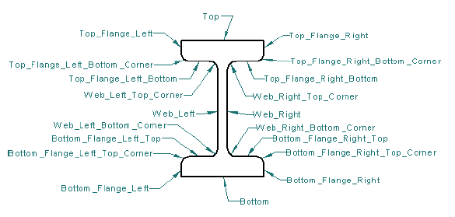
2D Symbol Utility
Edge Names
The geometry of a symbol consists of a closed contour comprised of lines and arcs. In order for the software to know which line or arc corresponds to which part of the symbol, you must name each geometric element.
Example:
© 2009. Intergraph Corporation. All Rights Reserved.

Slide 42
2D Symbol Utility
Edge Names (Cont’s)
  Hard coded in the software. You can not change the edge names.
  A profile cross-section, with the exception of pipe and round tube, must have at least the following four edge names defined: Top, Bottom, Web left and Web right.
© 2009. Intergraph Corporation. All Rights Reserved.

Slide 43
2D Symbol Utility
Cross-Section Add-in Toolbar
Symbol Representation
Delete Symbol Properties
Name Geometry
Add Point properties
Symbol Properties
Add to Catalog
© 2009. Intergraph Corporation. All Rights Reserved.

Slide 44
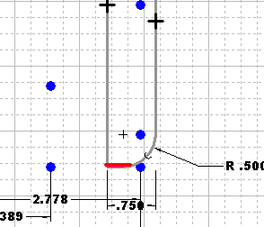
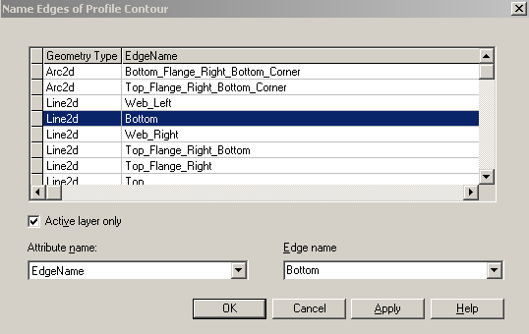
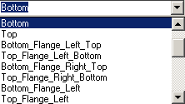
2D Symbol Utility
Name Edges dialog box
Name each geometry elements.
© 2009. Intergraph Corporation. All Rights Reserved.

Slide 45
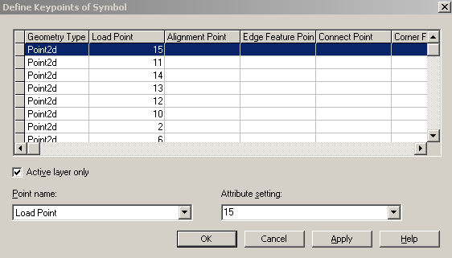
2D Symbol Utility
Define Key Points dialog box
Done in the Delivered Template
© 2009. Intergraph Corporation. All Rights Reserved.

Slide 46
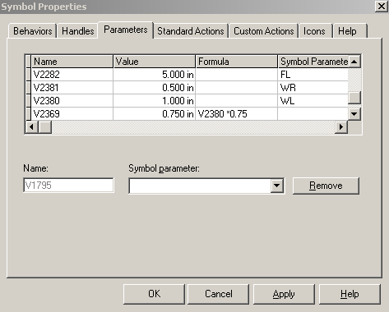
2D Symbol Utility
Define Symbol Properties dialog box
Maps symbol variables to the corresponding symbol parameters in the spreadsheet.
The symbol parameters
are listed on the Custom
Interface sheet.
© 2009. Intergraph Corporation. All Rights Reserved.

Slide 47
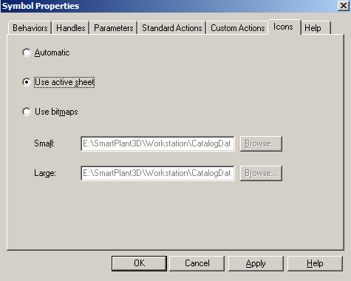

2D Symbol Utility
Create the Symbol Icon
© 2009. Intergraph Corporation. All Rights Reserved.

Slide 48
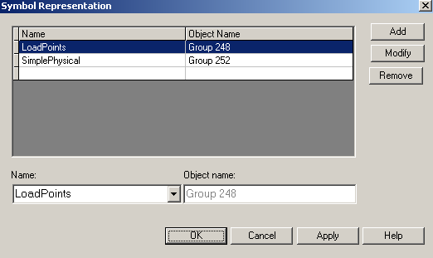
2D Symbol Utility
Symbol Representation dialog box
Maps the profile geometry groups to the corresponding symbol representation.
© 2009. Intergraph Corporation. All Rights Reserved.

Slide 49
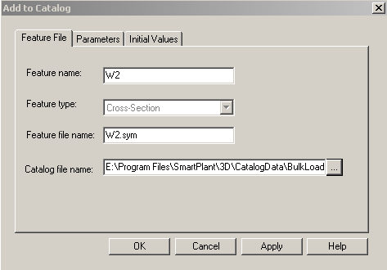
2D Symbol Utility
Add to Catalog dialog box
Add the part class of the symbol to the appropriate Excel spreadsheet.
© 2009. Intergraph Corporation. All Rights Reserved.

Slide 50
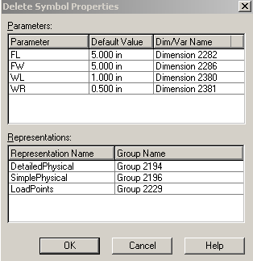

2D Symbol Utility
Delete Symbol Properties dialog box
© 2009. Intergraph Corporation. All Rights Reserved.

Slide 51
2D Symbol Utility
Part 2: Steps for creating Profile Cross-Section (Continue..)
  Open the Cross-Section Add-in Toolbar
  Name Profile Edges
  Define Profile Key Points (Done in our delivered template)
  Define Profile Symbol Properties
  Create Profile Symbol Representations
  Create Load Point Symbol Representation
  Add the part class of the symbol to the appropriate Excel spreadsheet.
© 2009. Intergraph Corporation. All Rights Reserved.

Slide 52
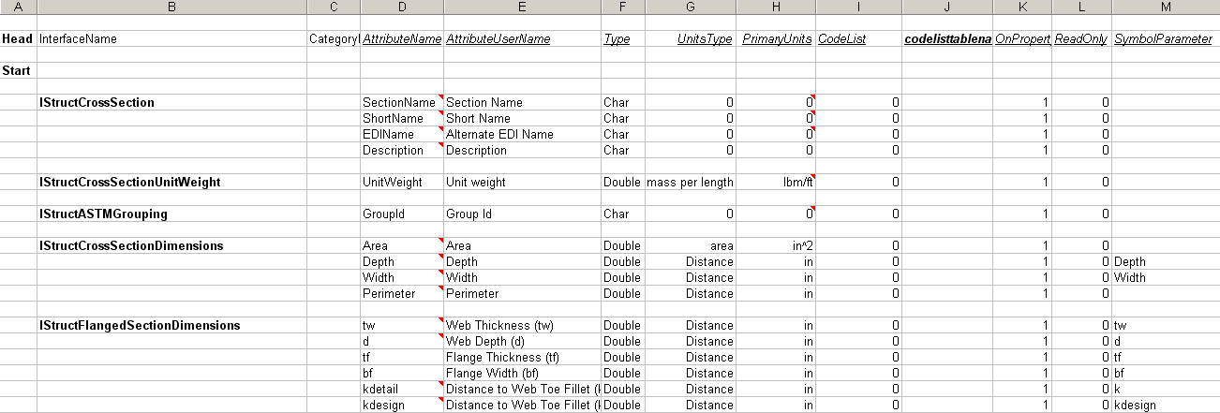
Custom Interfaces sheet
The parameters defined in the symbol are entered as attributes in the spreadsheet.
© 2009. Intergraph Corporation. All Rights Reserved.

Slide 53
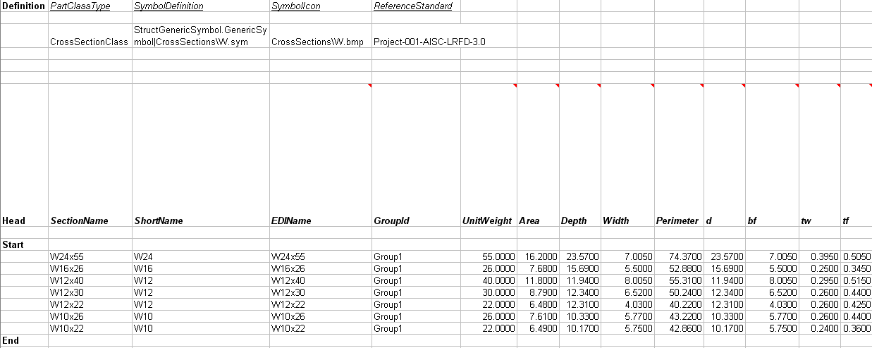
Section sheet
The Section Sheet is created by the Add to Catalog command. The sheet specifies the name of the symbol, and values for different sizes of the section.
© 2009. Intergraph Corporation. All Rights Reserved.

Slide 54




Openings - Overview
  Cutout feature that removes material from Slabs and Members
  Cutout operation is performed by using a contour defined by three methods:
    Bounded by general topology (edges, faces)
    Sketch method
    Select an opening from Catalog
  Supports full-depth or partial-depth cutouts
© 2009. Intergraph Corporation. All Rights Reserved.

Slide 55

Openings – Overview
Parametric 2D opening shapes from catalog
© 2009. Intergraph Corporation. All Rights Reserved.

Slide 56

Openings - Overview
Pre-defined opening shapes are defined in the reference data.
StructOpeningsMetric.xls
Catalog
Bulkload Utility
OvalOpening.sym
Symbol 2D Utility
OpeningTemplate.sym
© 2009. Intergraph Corporation. All Rights Reserved.

Slide 57

2D Symbol Utility
Main Menu
Ribbon bars
2D Drafting Environment
Common Windows Interface
- Ribbon Bars
- Graphic Views
  OpeningTemplate.sym
Opening dialog bar
Active View
Draw Toolbar
Status Bar
© 2009. Intergraph Corporation. All Rights Reserved.

Slide 58

Creating Openings
The (0,0) origin point of the 2D Symbols file is used as the default placement point for the symbol.
© 2009. Intergraph Corporation. All Rights Reserved.

Slide 59
2D Symbol Utility
Layers
Can help groups elements so they can manipulated more easily on the drawing sheet.
Symbol Organization
  Default
  Dimensions
Dimension Layer
Default Layer
© 2009. Intergraph Corporation. All Rights Reserved.

Slide 60

2D Symbol Utility
Construction elements are used to aid in the definition and proper constraint of the final symbol geometry. Because of the way Openings are placed into a RAD2D view, Opening symbols can be constrained using horizontal and vertical constraints.
© 2009. Intergraph Corporation. All Rights Reserved.

Slide 61

2D Symbol Utility
Delivered Template
[Install Directory]\Common2D\Symbol2D\Templates
OpeningTemplate.sym
Layers
- Default
- Dimensions
© 2009. Intergraph Corporation. All Rights Reserved.

Slide 62

2D Symbol Utility
Define, constrain, dimension and trim the geometry elements required to complete the symbol contour
© 2009. Intergraph Corporation. All Rights Reserved.

Slide 63

2D Symbol Utility
Creating Opening Group
Shift-click to select the lines and arcs that define the contour of the opening. This group will be the output for the symbol. Do not select points, construction lines, dimensions, or constraints.
The geometry for the group must be selected in order in a clockwise direction. As geometry is picked, the contour should always form a continuous curve and form a closed polygon when complete.
Group
Ungroup
© 2009. Intergraph Corporation. All Rights Reserved.

Slide 64


2D Symbol Utility
The Define Symbol Properties form displays all variables and their names, values, and formulas in the symbol. Symbol parameters are also defined on this form; these are the symbol properties that are externalized to the Excel spreadsheet bulkload file.
© 2009. Intergraph Corporation. All Rights Reserved.

Slide 65

2D Symbol Utility
Create the Symbol Icon
© 2009. Intergraph Corporation. All Rights Reserved.

Slide 66

2D Symbol Utility
Symbol Representation dialog box
Create the symbol representation
© 2009. Intergraph Corporation. All Rights Reserved.

Slide 67

2D Symbol Utility
Add to Catalog dialog box
Add the symbol to the appropriate Excel spreadsheet
© 2009. Intergraph Corporation. All Rights Reserved.

Slide 68

2D Symbol Utility
Delete Symbol Properties dialog box
© 2009. Intergraph Corporation. All Rights Reserved.

Slide 69
2D Symbol Utility
Steps for creating Opening
  Use the delivered opening template
  Use the layer toolbar to switch between layers
  Sketch the opening on the default layer using the draw tools
  Dimension and Constrain the opening using the relationship tools (Do not over constrain)
  Add formulas as needed using the Variable Table (Optional)
  Create opening group
  Define opening symbol properties
  Create opening symbol representation
  Add the symbol to the appropriate Excel spreadsheet
© 2009. Intergraph Corporation. All Rights Reserved.

Slide 70

The User Attributes Sheet
Custom Interfaces sheet
The parameters defined in the symbol are entered as attributes in the spreadsheet.
© 2009. Intergraph Corporation. All Rights Reserved.

Slide 71

Opening sheet
The Opening Sheet is unique for each symbol, and is created by the Add to Catalog command. The sheet specifies the name of the symbol, and values for different sizes of the opening.
Multiple openings can be added, using a single symbol. To add another opening size, another line is added to the sheet, with a different Part Number and different parameter values.
Values are filled in for the opening parameters. Currently, they default to mm, but can be changed to any unit, as long as the unit is specified.
© 2009. Intergraph Corporation. All Rights Reserved.

Slide 72


ClassNode Type sheet
The ClassNodeType sheet will provide the name for the Opening Node. This will be the name that is seen by the user.
© 2009. Intergraph Corporation. All Rights Reserved.

Slide 73

R-Hierarchy sheet
The R-Hierarchy Sheet will create a node in the database for the Opening class, under the Structure Root.
© 2009. Intergraph Corporation. All Rights Reserved.

Slide 74


R-ClassNodeDescribes sheet
The R-ClassNodeDescribes sheet creates an entry in the database, under the Openings node, for the opening.
© 2009. Intergraph Corporation. All Rights Reserved.

Slide 75


Slab Overview
Type:
Specifies the “Type” of slab as defined from reference data.
The slab type drives the Composition selection.
Composition:
  Specifies the “Composition” of slab layers
  as scoped from the currently selected
  “Type” of slab’.
© 2009. Intergraph Corporation. All Rights Reserved.

Slide 76
Slab Reference Data - Example
Struct Slab General Workbook
Slab General Type
Class Data
Type: Floor Deck
Composition: Steel deck
Fire rating: 2hrs
Slab Composition Type
Class Data
Struct Slab Layer Workbook
Steel deck
Layer Number: 1
Layer Type: Corrugated
Layer part number: 1.5B24
Layer Class
Data
1.5B24 Material: Steel - Carbon
Grade: A569
Thickness: 1.5”
Corrugated
© 2009. Intergraph Corporation. All Rights Reserved.

Slide 77

Slab General Type sheet
Defines the default attributes for each slab type
Example: Fire rating, etc….
- Drives the composition selection.
© 2009. Intergraph Corporation. All Rights Reserved.

Slide 78

Slab General Type sheet
Face position
© 2009. Intergraph Corporation. All Rights Reserved.

Slide 79

Slab General Type sheet (Cont..)
© 2009. Intergraph Corporation. All Rights Reserved.

Slide 80

Slab Composition sheet
The Composition defines the slab layer configuration.
It describes the layer number, the order of the layer, and for each layer type: the layer type and the layer part number.
© 2009. Intergraph Corporation. All Rights Reserved.

Slide 81

Corrugated Layer sheet
Defines the properties of the specified layer
© 2009. Intergraph Corporation. All Rights Reserved.

Slide 82

Concrete Layer sheet
Defines the properties of the specified layer
© 2009. Intergraph Corporation. All Rights Reserved.

Slide 83

Custom Interfaces sheet
© 2009. Intergraph Corporation. All Rights Reserved.

Slide 84

Custom Interfaces sheet
© 2009. Intergraph Corporation. All Rights Reserved.

Slide 85
Slab Reference Data - Overview
Code List
Fastener type
Face position
Manufacturing process ….
Struct Slab General Workbook
Slab General Type
Class Data
Type
Composition
Fire rating …..
Slab Composition Type
Class Data
Struct Slab Layer Workbook
Layer Class
Data
Material
Grade
Thickness ……
Layer Number
Layer Type
Layer part number…….
© 2009. Intergraph Corporation. All Rights Reserved.

